Slide 1


GEO‑AI Sentinel: Real‑Time Disaster Monitoring
Micro‑Patch Streaming + Edge AI on GEO Platforms
31/01/2026

Slide 2

Airbus ADS #3 – Fight for our Planet with Airbus Earth Observation data
The Challenge
Existing GEO platforms suffer from high latency and deliver raw data requiring extensive ground processing
LEO Limitations
LEO constellations provide fast imaging but cannot continuously monitor the same region
Our Innovation
Cost-effective GEO satellite with Edge AI detecting fires and thermal anomalies within 1–5 minutes
DOCUMENT TITLE

Slide 3
Critical Gaps in Current GEO Monitoring
Performance Barriers
Traditional GEO satellites deliver ~1 km ground pixel resolution, transmitting massive volumes of raw data that overwhelm ground systems and delay critical response times by hours.
Coarse Resolution
~1 km ground pixel provides insufficient detail for early fire detection
Data Overload
High volumes of raw data create costly transmission and storage requirements
Response Delays
Hours-long processing times reduce disaster response effectiveness
No Intelligence
Lack of onboard processing prevents real-time event identification
DOCUMENT TITLE

Slide 4

GEO Orbit + Edge AI: A Game-Changing Architecture
Our solution combines geostationary positioning with intelligent onboard processing to revolutionize thermal anomaly detection.
Patch Analysis
AI divides full imagery into 1 km² patches for parallel processing
Smart Detection
Onboard AI analyzes each patch for thermal signatures and anomalies
Priority Transmission
Critical patches sent immediately; full imagery transmitted later
1-5
70%
1/3
Minutes to Alert
vs. 1-3 hours with traditional systems
Cost Reduction
Compared to deploying new LEO constellations
Cost Reduction
Compared to deploying new LEO constellations
DOCUMENT TITLE

Slide 5
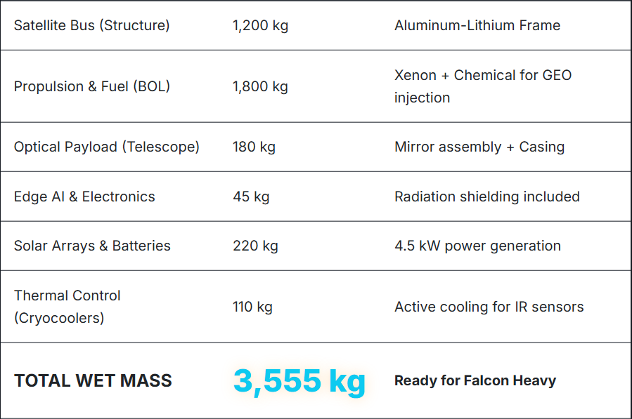
Technical Architecture: Proven Platform, Advanced Payload
LWIR Thermal Imaging Payload
Optical System: Catadioptric/Reflective design
Aperture: 250–400 mm
Focal length: 1.5–2.5 m
Materials: Germanium (Ge), Zinc Selenide (ZnSe), DLC coating
Sensor: 640×512 or 1024×1024 microbolometer array
Ground resolution: ~1 km per pixel at GEO
Edge AI Processing: Radiation-hardened SoC/FPGA architecture enables sub-pixel thermal anomaly detection and selective data transmission.
Satellite Platform
DOCUMENT TITLE

Slide 6
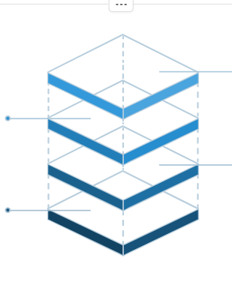
Optical Physics: Sub-Pixel Fire Detection
Detection Capability
Diffraction Limit: D = 0.25–0.4 m, λ = 10 μm → Ground Spot ≈ 800–1,000 m
Small fire hot spots create measurable temperature increases within larger pixels, enabling sub-pixel detection through thermal signature analysis.
The diffraction-limited ground spot size enables detection of thermal signatures significantly smaller than one pixel through thermal analysis.
Ground Spot
800–1000 m spot at GEO
Diffraction Limit
θ ≈ 1.22 λ/D calculation
Wavelength
Long-wave IR at 10 μm
Aperture
250–400 mm telescope diameter
Early Detection
Identify fires before visible expansion using thermal signatures
Optimized Design
Reduced launch mass and cost through targeted capability
Location Identification
Pinpoint thermal anomaly presence and coordinates
DOCUMENT TITLE

Slide 7
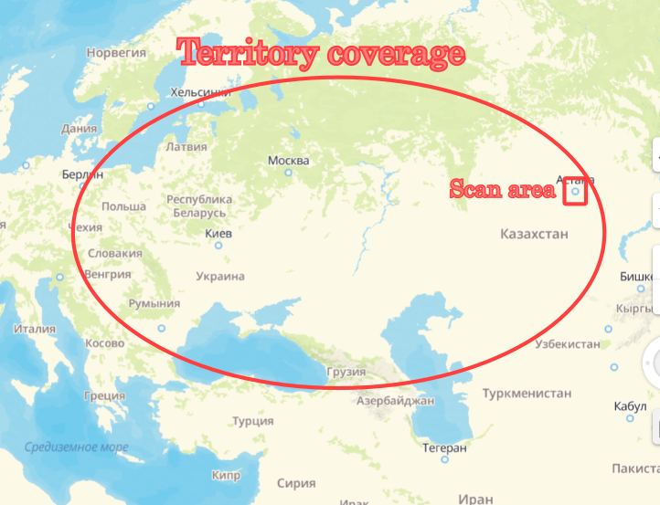
Global Coverage with Strategic Priority Zones
GEO Orbit Advantages
From 35,786 km altitude, a single satellite provides continuous monitoring of approximately one-third of Earth's surface, extending to ±60° latitude.
Micro-Patch Streaming
Intelligent prioritization ensures high-risk regions receive immediate attention: wildfire zones, protected forests, critical infrastructure, and densely populated urban areas.
DOCUMENT TITLE

Slide 8
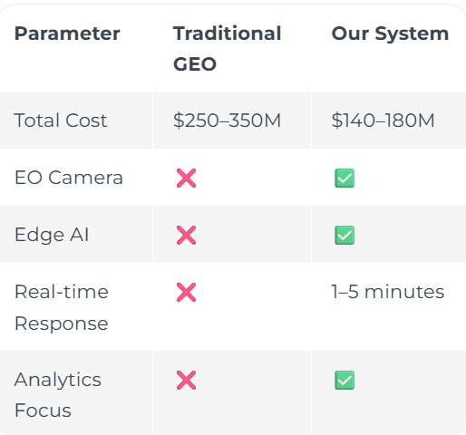
Competitive Advantage vs. Traditional GEO Systems
Simplified Mission
Not a wideband telecom satellite—eliminates high-power transponder requirements
Optimized Optics
LWIR system sized for fire detection with smaller aperture and lower mass
Platform Reuse
Leverage demounted legacy GEO platforms from Airbus inventory
Targeted Capability
No unnecessary multispectral channels—focused thermal detection only
DOCUMENT TITLE

Slide 9
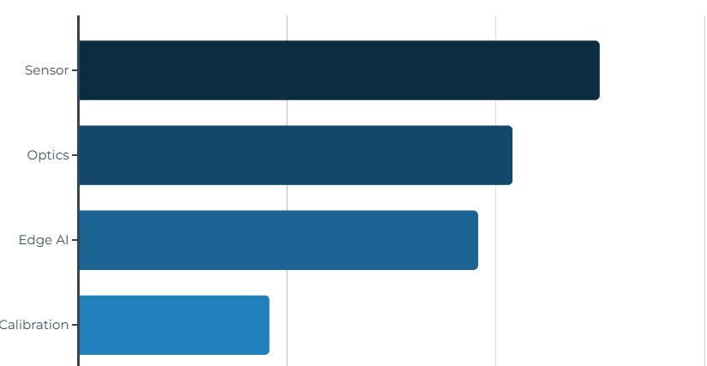
Payload Breakdown and Mission Budget
LWIR Payload Components
Sensor ($1.2–1.8M): 640×512 or 1024×1024 microbolometer, 17–25 μm pitch, NETD <50 mK
Optics ($0.9–1.6M): Ge/ZnSe materials, DLC coating, 250–400 mm aperture, f/1.5–2.5
Edge AI ($0.8–1.5M): Radiation-hardened SoC/FPGA for onboard processing
Calibration ($0.4–0.7M): Thermal stabilization and sensor calibration systems
Total Payload: $3.3–5.6M | Complete Mission: $140–180M including production, integration, and launch
DOCUMENT TITLE

Slide 10
Implementation Roadmap
Phase 1: Integration
Integrate LWIR sensor and Edge AI system into legacy GEO Airbus platform, leveraging existing Eurostar architecture
1
2
Phase 2: Validation
Conduct comprehensive ground testing and thermal sensor calibration in simulated space environment
Phase 3: Launch
Deploy via Ariane 6 or Falcon Heavy shared launch to geostationary orbit
3
Phase 4: Operations
Monitor high-risk regions for thermal anomalies with 1-5 minute alert latency
4
Phase 5: Expansion
Scale capabilities for floods, volcanic activity, and energy grid monitoring
5
DOCUMENT TITLE

Slide 11


Check Our Project
THANK YOU
FOR WATCHING
CONTACTS
Nikita Sidiropulo Alekseevich
leftstrice_321@bk.ru
+7 771 353 4885
Kuanbek Ibragim Askaruli
i.kuanbek@aues.kz
+7 707 686 40 57
Maral Ali
al.maral@aues.kz
+7 706 684 25
DOCUMENT TITLE

